Slide 1
ETL Concepts – Data Warehouse

Slide 2
ETL for the Data Warehouse
What is a Data Warehouse?
A data warehouse is a subject-oriented, integrated, non-volatile, time-variant collection of data in support of management’s decisions.
Can I see Sales report from marketing, order report for this customer
Data stored for historical period. Data is populated in the data warehouse on daily/monthly basis depending upon the requirement
Data from multiple sources is integrated for a subject
Identical queries will give same result at different times. Support analysis requiring historical data

Slide 3
Need for ETL for DW
Businesses have data in multiple databases with different codification and formats.
Mergers and acquisitions have also created disparities in data representation
Transformation is required to convert and summarize operational data into a consistent, business oriented form.
Compute any derived information and aggregates.
To maintain historic data in retrievable form.

Slide 4

Objectives
Data Extraction
Data Staging
Data Transformation
Changed data determination
Data Load

Slide 5
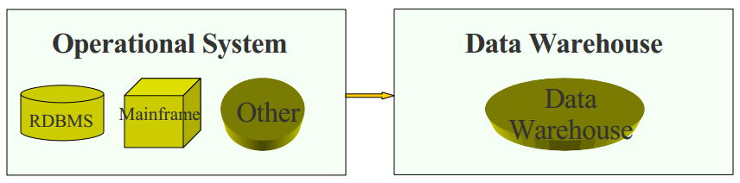
Operational System to Data Warehouse
Transaction level data
Optimized for Transaction
Response Time
Current
Normalized or De-Normalized data
Aggregated Data
Optimized for Query Response Time
Historical
Normalized or De-Normalized data

Slide 6
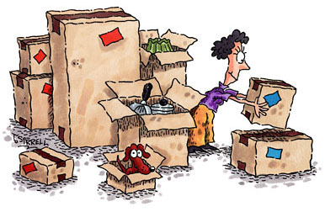
Data Extraction /Sourcing
Sandra has shifted to a new house. She decides to setup her kitchen today.
Can you help her locate the required boxes?

Slide 7
Data sourcing steps
Figure out what data you need
Step 1 Data Needs Specification
Substantiate where the data will come from
Step 2 Data Systems Sourcing
Determine where the data you need might be found
Step 3 Data Source Verification
Define the criteria to be met to convert the data into the form required by the new system
Step 4 Data Preparation Requirements

Slide 8
Data Extraction
OLTP Systems (incremental data)
Legacy Systems (historic data)
Extract data
Text files
Spreadsheets & others

Slide 9
Data Extraction
The analysis of the source system is usually broken into two major phases:
The data discovery phase
The anomaly detection phase

Slide 10
Data Discovery Phase
key criterion for the success of the data warehouse is the cleanliness and cohesiveness of the data within it
Once you understand what the target needs to look like, you need to identify and examine the data sources

Slide 11
Data Content Analysis - Extraction
Understanding the content of the data is crucial for determining the best approach for retrieval - NULL values An unhandled NULL value can destroy any ETL process. NULL values pose the biggest risk when they are in foreign key columns. Joining two or more tables based on a column that contains NULL values will cause data loss Remember, in a relational database NULL is not equal to NULL. That is why those joins fail. Check for NULL values in every foreign key in the source database. When NULL values are present, you must outer join the tables - Dates in nondate fields Dates are very peculiar elements because they are the only logical elements that can come in various formats, literally containing different values and having the exact same meaning. Fortunately, most database systems support most of the various formats for display purposes but store them in a single standard format

Slide 12

Data Staging
John’s Manager has mailed him a set of important client documents and asked him to modify and club them to form one document.
John downloads all the documents. Deletes the mail because of its large size and starts merging the documents. While updating the document his computer restarts due to some systems error and the data is lost. John is worried because his manger might scold him for his negligence.
What do you think was Jonh’s mistake?

Slide 13
What is Data Staging and its need
It should be possible to restart, at least, some of the phases independently from the others. For example, if the transformation step fails, it should not be necessary to restart the Extract step.
We can ensure this by implementing proper staging.
Staging means that the data is simply dumped to the location (called the Staging Area) so that it can then be read by the next processing phase.
The staging area is also used during ETL process to store intermediate results of processing. This is ok for the ETL process which uses for this purpose.
However, the staging area should be accessed by the load ETL process only. It should never be available to anyone else; particularly not to end users as it is not intended for data presentation to the end-user because it may contain incomplete or in-the-middle-of-the-processing data.
Data is either directly copied/landed into the staging area or optionally cleansed, sorted & refined to some extent.

Slide 14
Data Staging
OLTP Systems (incremental data)
Staging/Landing Area (Cleaning
Combining
Quality Assure
Sorting
Matching
Verify)
Legacy Systems (historic data)
Extract data
Text files
Spreadsheets & others

Slide 15
Change Data Capture
What is Change data Capture (CDC)?
It is a set of software design patterns used to determine (and track) the data that has changed so that action can be taken using the changed data. Also, Change data capture (CDC) is an approach to data integration that is based on the identification, capture and delivery of the changes made to enterprise data sources
Example:
Employee source table having a column namely LAST_UPDATED_DATE. Whenever there is any change in the status of the employee or when a new employee joins the organization this column value also gets updated.

Slide 16
Data Transformation
The Transform step applies a set of rules to transform the data from the source to the target.
Transformation step requires
joining data from several sources
generating aggregates
generating surrogate keys
sorting
removing duplicates
deriving new calculated values
applying advanced validation rules
Institute policies, procedures and systems to monitor and assure the ongoing quality and integrity of the data being loaded.

Slide 17
Data Transformation examples
Selecting only certain columns to load
Translating coded values (e.g., if the source system stores 1 for male and 2 for female, but the warehouse stores M for male and F for female)
Encoding free-form values (e.g., mapping "Male" to "M")
Deriving a new calculated value (e.g., Age = current day – date of birth)
Joining data from multiple sources
Aggregation (for example, rollup — summarizing multiple rows of data — total sales for each store, and for each region, etc.)
Generating surrogate-key values

Slide 18
ETL process till Transformation
OLTP Systems (incremental data)
Staging/Landing Area (Cleaning
Combining
Quality Assure
Sorting
Matching
Verify)
Extract data
Data Transformations (Joining,
Aggregation,
Deduplicating,etc)
Legacy Systems (historic data)
Text files
Spreadsheets & others

Slide 19
Changed Data Determination
During the initial load, capturing changes to data content in the source data is unimportant because you are most likely extracting the entire data source or a potion of it from a predetermined point in time.
Later the ability to capture data changes in the source system becomes priority
The ETL team is responsible for capturing data-content changes during the incremental load.

Slide 20
Changed Data Determination
Audit columns are appended to the end of each table to store the date and time a record was added or modified
Example: Columns like Created_date, Created_by, Updated_dt and Updated_by help us determine when and by whom the row was last updated
Process of Elimination
Process of elimination preserves exactly one copy of each previous extraction in the staging area for future use.
During the next run, the process takes the entire source table(s) into the staging area and makes a comparison against the retained data from the last process.
Only differences (deltas) are sent to the data warehouse.
Not the most efficient technique, but most reliable for capturing
changed data

Slide 21
Changed Data Determination
Initial Load
Create previous load and current load tables
Current Load
Target
Initial Process
Bulk load
Transform
Drop Previous Load Table
Incremental Loads
Rename Current load table to Previous load table
Current Load
Create empty Current Load table
Incremental process
Target
Current Load
Previous Load
Drop Previous Load Table
Transform
minus
Since none of these tasks involve database logging, they are very fast!

Slide 22
Data Load
Loading is the last step of ETL process.
The Load phase loads the transformed data from source to the target.
The target is usually the data warehouse.
There are two types of tables in the database structure: fact tables and dimensions tables
Data is loaded into normalized tables into the data warehouse.

Slide 23
Type of ETL Loads
Loading of data from legacy systems into the DW. We perform a one time ETL to extract the required history data and load it to the warehouse.
History Load/Initial Load
Incremental Load
Incremental load is the periodic load to keep the data warehouse updated with the most recent transactional data.
Load could be on
Daily basis Weekly basis
Monthly basis Quarterly basis
Yearly basis

Slide 24
ETL Process
OLTP Systems (incremental data)
Transformation
Extract data
Legacy Systems (historic data)
Staging/Landing Area
Data Warehouse
Text files
Spreadsheets & others

Slide 25

Test your understanding
Why is data staging required?
What are the types of ETL loads?
What is data sourcing?
Why do we need Change data determination in ETL?

Slide 26
Solution
Staging is required to serve as a backup for data and preliminary data cleansing
Historic load & Incremental load
Locating the data & fetching it
History is important & changes need to be captured

